Slide 1


Comparing Across Apps
New Verticals Download
Kelly Peterson
Date: June 16, 2023

Slide 2

Research Objectives
We know that a subset of Cx are value seekers who compare cost across multiple apps before placing an order. This research is targeted to understand:
Where do Cx go on each app to look for deals and discounts when ordering? What pathways do they take to compare across apps?
What cost factors are compared and what weight do they hold (e.g. item price, delivery fees, service fees, recommended tips)?
How do Cx make a final decision? What factors have the greatest weight?
This deck looks specifically at grocery comparisons. It is a subset of the research study comparing across apps

Slide 3

Research Approach
RESEARCH PARTICIPANTS
Survey n=443 DoorDash Cx who compare Rx; n=284 compare for Rx & NV
Included a mix of classic, occasional and DashPass Cx
Included a mix of Cx who compare every time they order vs. less frequently
Data was weighted to correctly reflect the Classic vs. DashPass DoorDash universe
SURVEY
IN-DEPTH INTERVIEWS
10 min Survey
Cx shared the frequency, priorities, decision making factors and approach when comparing across apps before ordering delivery
10, 25 min 1:1 Interviews
Cx shared their mobile screens to show how they compare across apps. Included Cx that compare DoorDash to UberEats, GrubHub as well as other sources
The research brief can be found here.
Notes:
James to link to failed session

Slide 4
What do NV Cx consider when comparing across apps

Slide 5
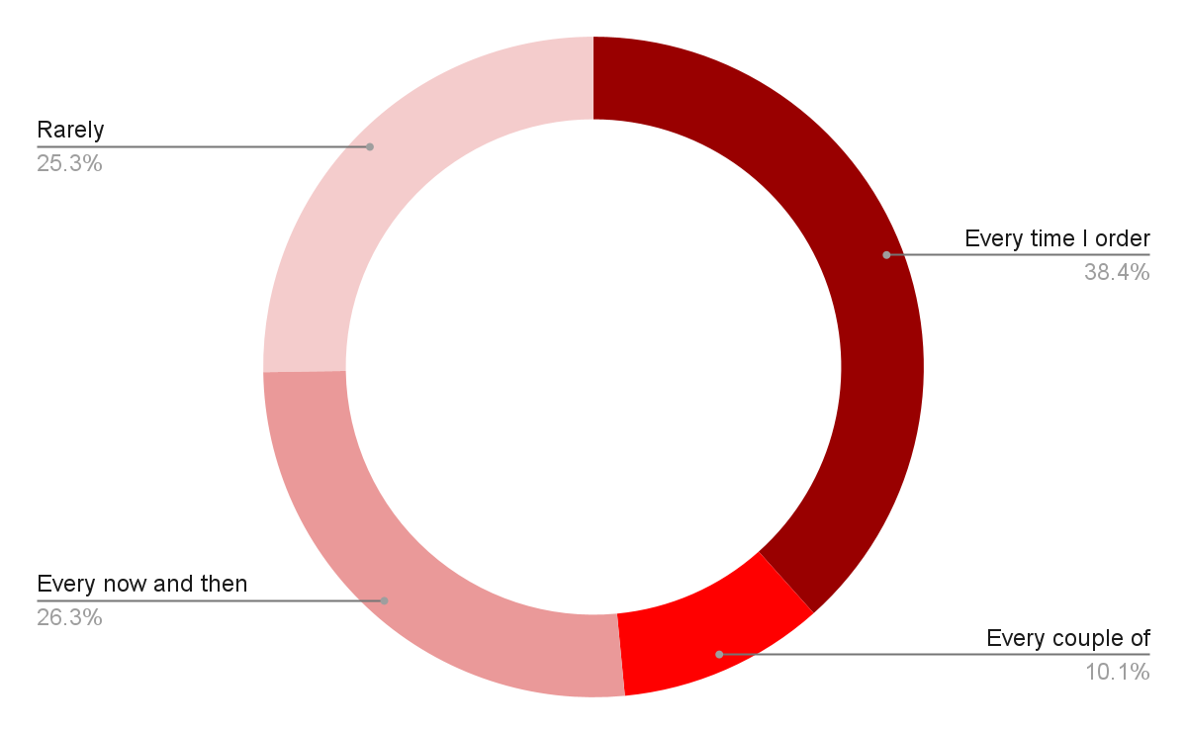







Cx that compare Rx compare grocery apps three-fourths of the time when ordering
Frequency of comparing apps when ordering grocery delivery:
Top apps used in comparison*:
 | 50%
 | 49%
 | 46%
 | 20%
 | 19%
 | 18%
 | 9%
Base: n=443 DoorDash users who compare apps for Rx
*Base: n=284 DoorDash users who order Grocery delivery
Source: Comparing Across Apps

Slide 6
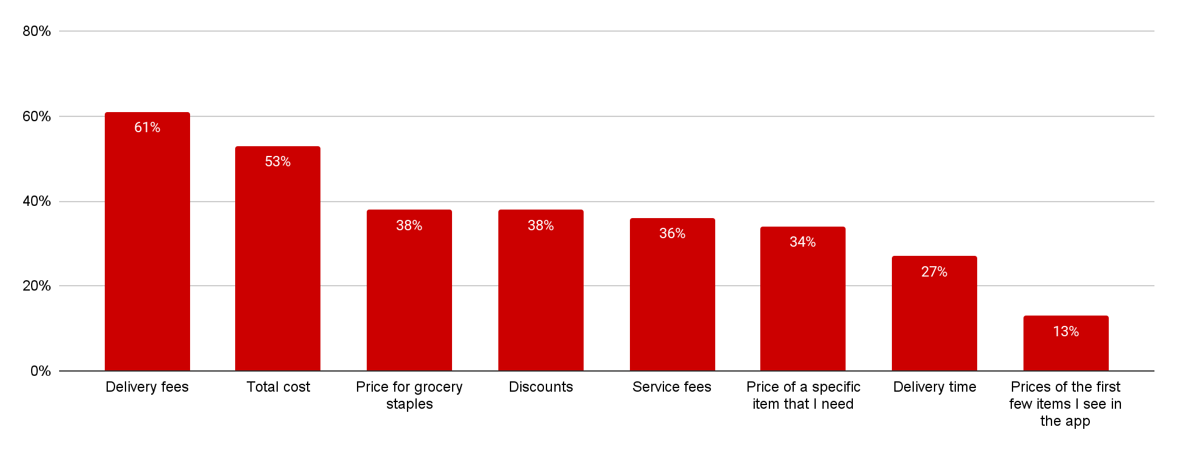








Delivery fees are the top considered factor when comparing apps
Top factors considered when comparing grocery orders across apps:
*Base: n=284 DoorDash users who order Grocery delivery
Source: Comparing Across Apps

Slide 7
Cx choose DoorDash because of individual cost features while Cx choose Instacart for total cost value and grocery staples.
Why do Cx choose ?
Why do Cx choose ?
1. | Delivery time
2. | Discounts/promos
3. | Delivery fees
4. | Total cost of order
5. | Service fees
1. | Delivery time
2. | Total cost of order
3. | Discount/promos
4. | Price of grocery staples
5. | Delivery fees
*Base: n=284 DoorDash users who order Grocery delivery
Source: Comparing Across Apps

